Slide 1

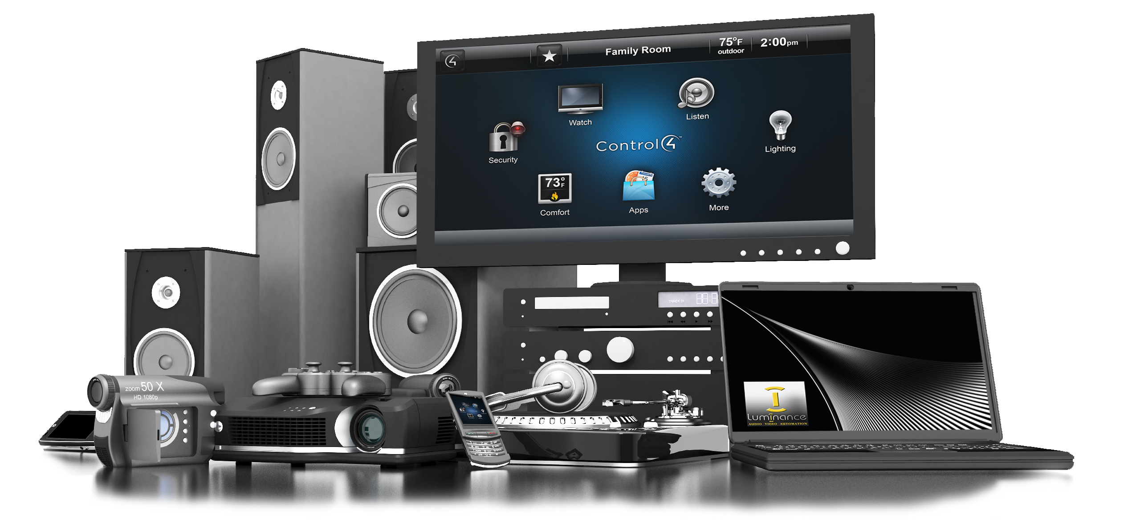

AD-HOC Analysis
Atliq Hardwares
Consumer goods
Created by : Pooja Sangwan

Slide 2
Company Details/Background
Objective
Getting familiar with Dataset and Tools
Ad-hoc requests along with the results, visualizations and insights.
Company Details

Slide 3
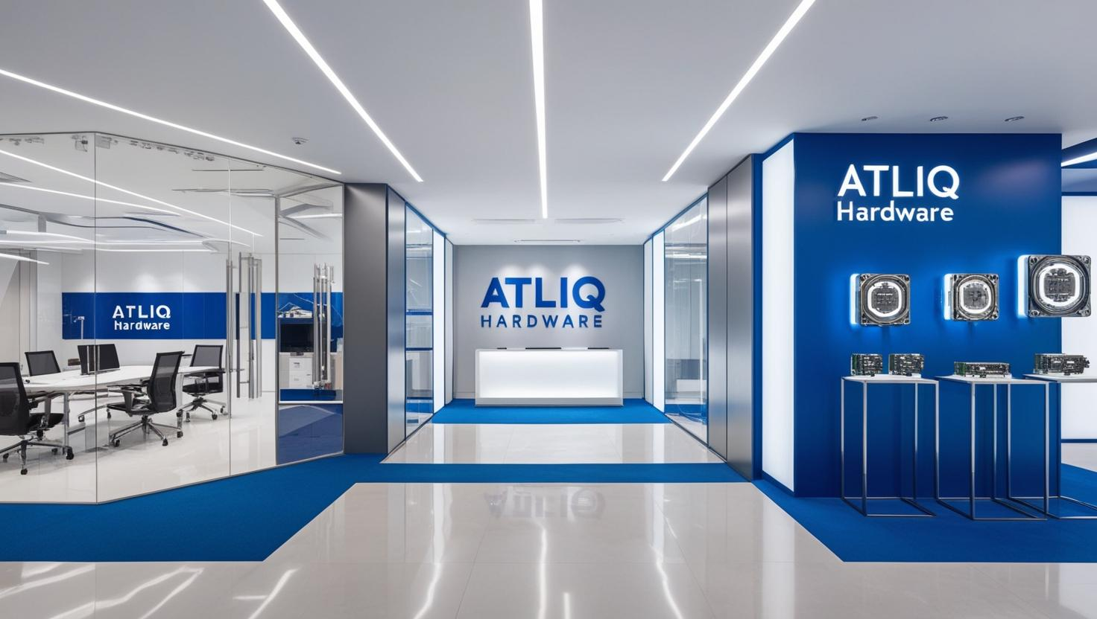
Company Details
Leading computer hardware producer in India.
Expanded presence in international markets.
Focused on innovation and growth.

Slide 4
Objective
Support Atliq Hardwares(imaginary company) in making smart, data-informed decisions.
The management lacks timely and actionable insights for data-driven decision-making.
To address this gap, the company plans to grow its data analytics team by hiring junior data analysts.
Contribute as a potential junior data analyst in the growing analytics team.

Slide 5
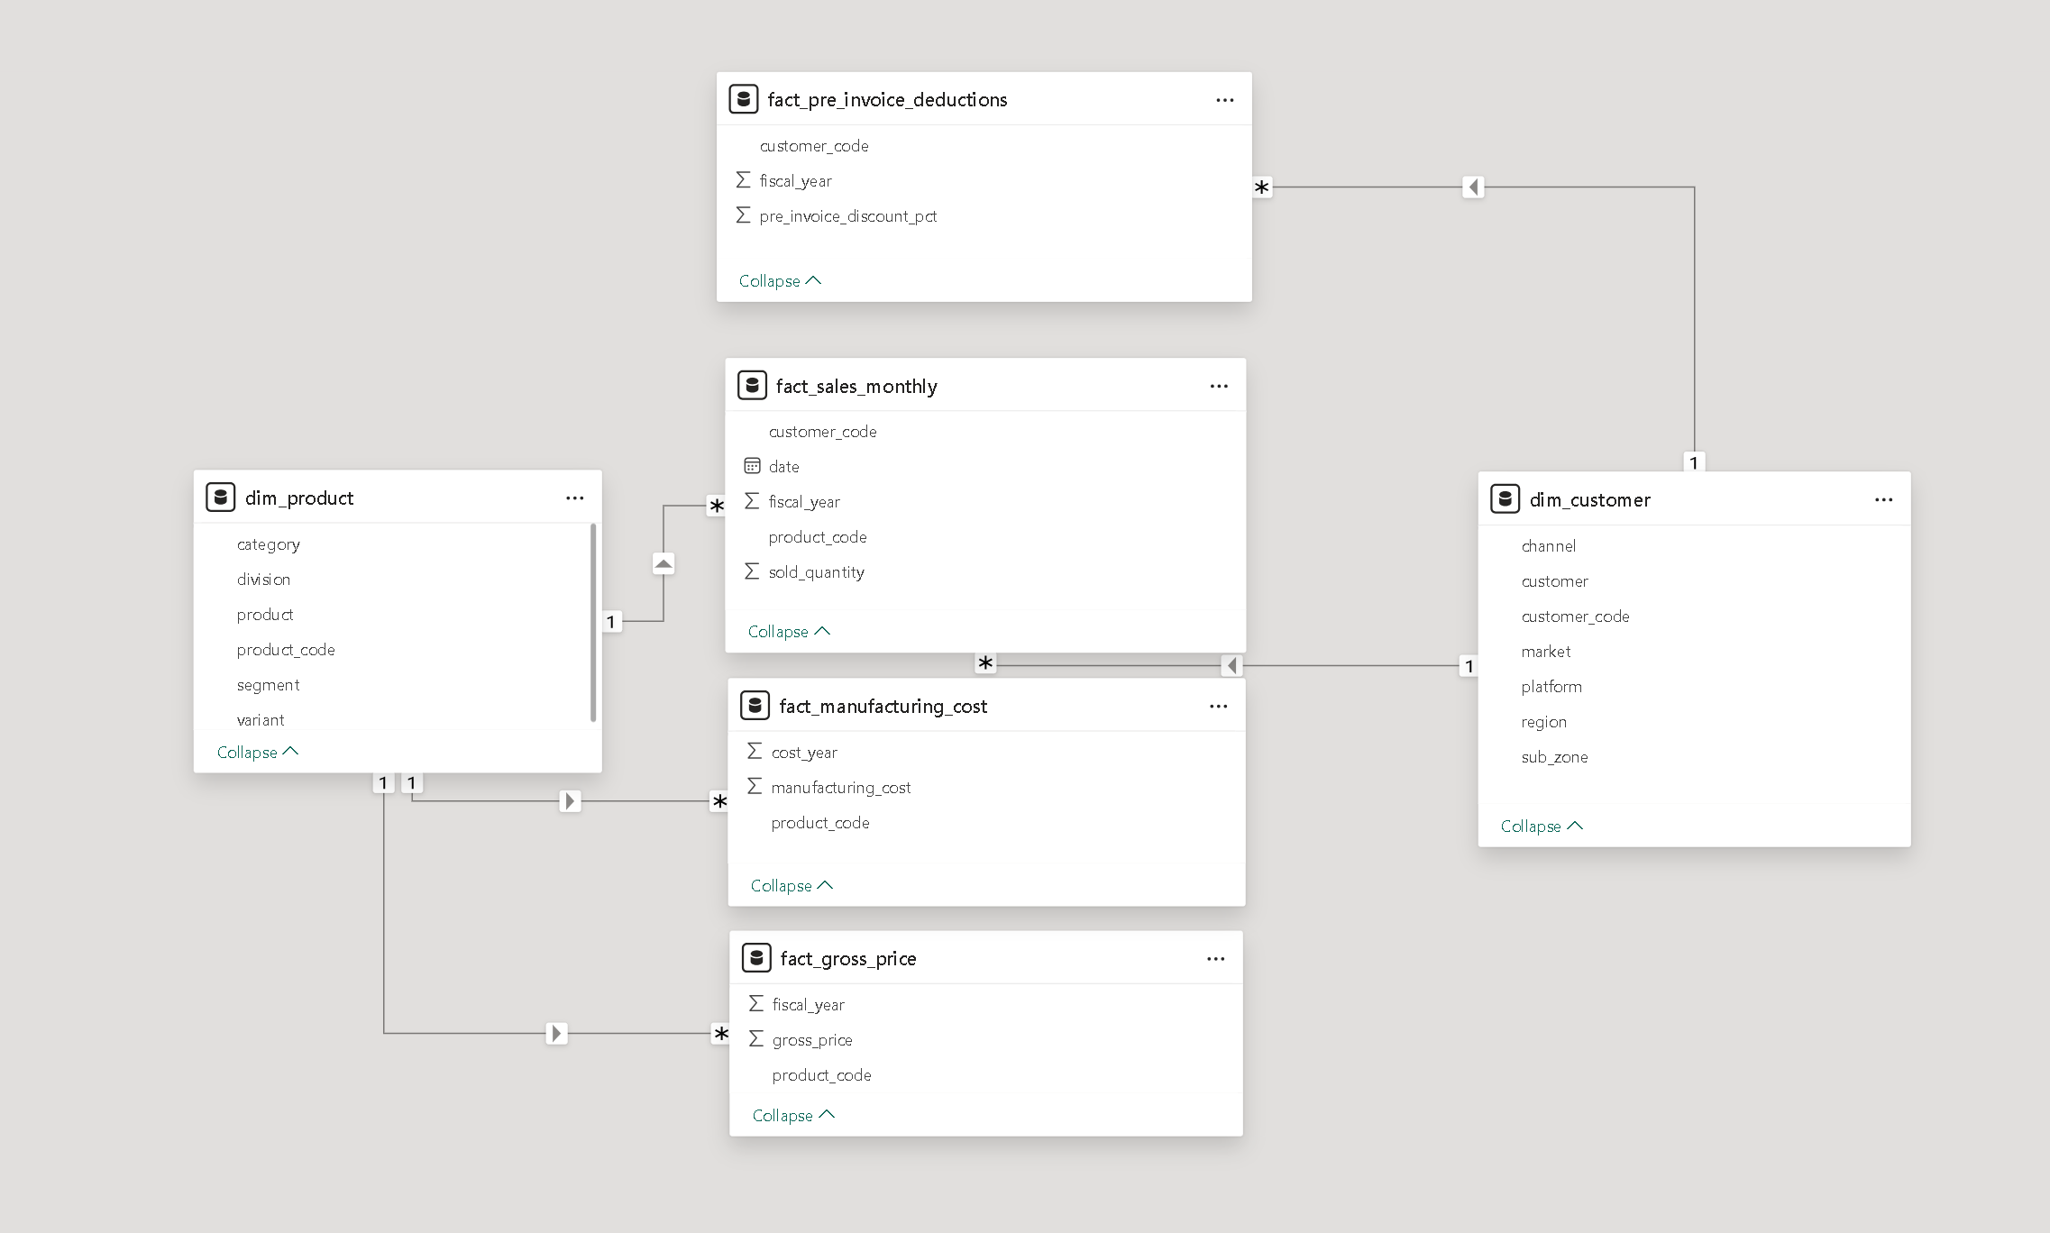


Getting familiar with Dataset and Tools

Slide 6
Atliq’s Product Line:
N&S
Networking
Storage
Wi-fi Extender
External SSD
USB Flash Drive
PC
Desktop
Notebook
Business Laptop
Personal Laptop
Gaming Laptop
Business Laptop
Personal Laptop
P&A
Peripherals
Accessories
Graphic Card
Internal HDD
Batteries
Keyboard
Mouse
Motherboard
Processors

Slide 7
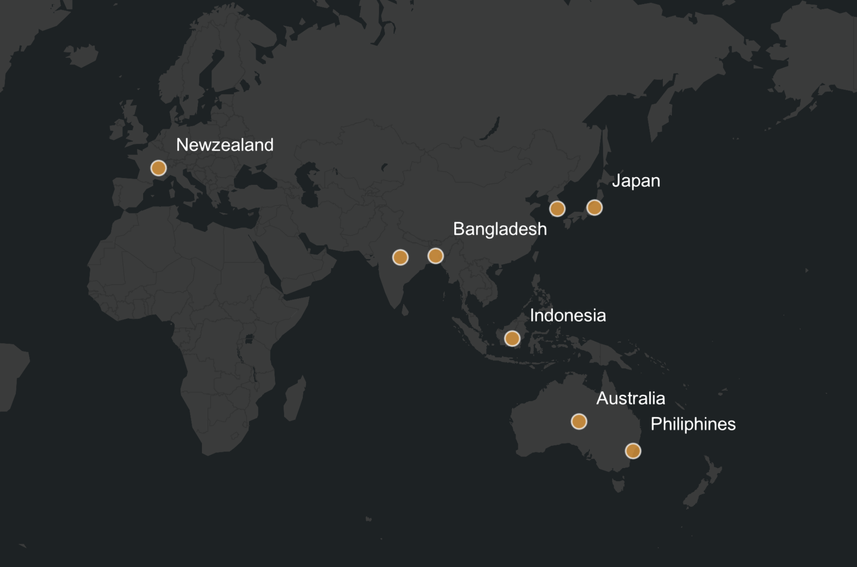
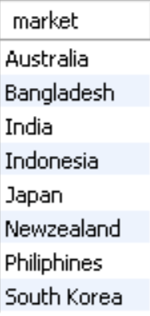
1. Provide the list of markets in which customer "Atliq Exclusive" operates its business in the APAC region.

Slide 8
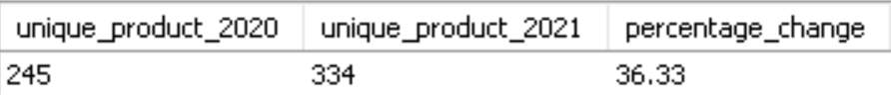
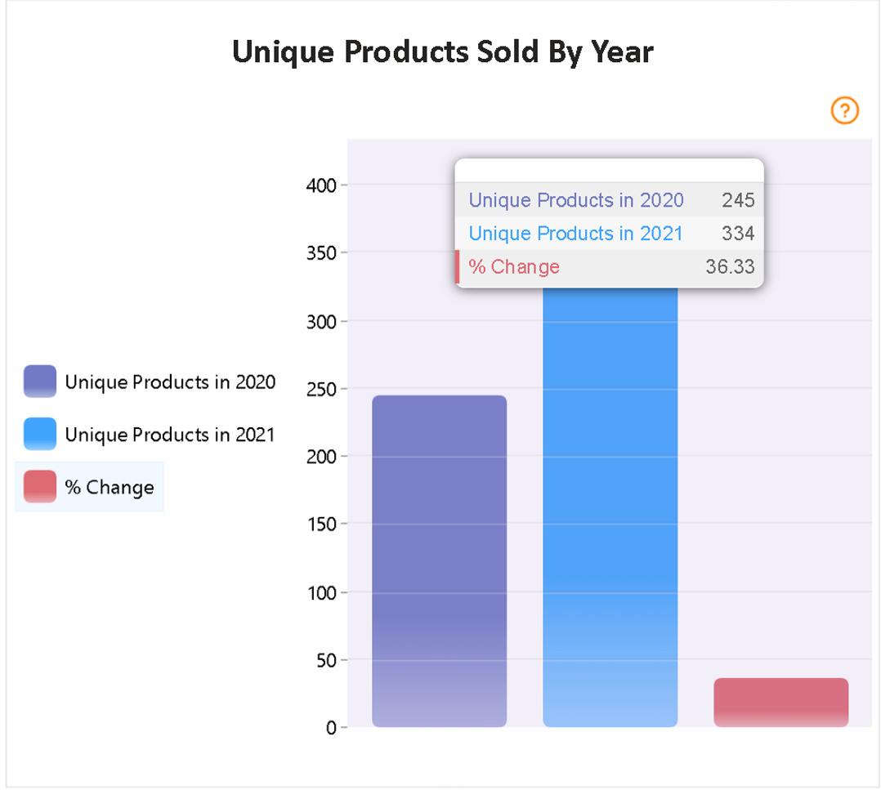
2. What is the percentage of unique product increase in 2021 vs. 2020? The final output contains these fields, unique_products_2020, unique_products_2021 percentage_chg.
Insight:
We continued to innovate and expand our offerings, increasing our product count from 245 in FY 2020 to 334 in FY 2021, reflecting a 36% growth.

Slide 9
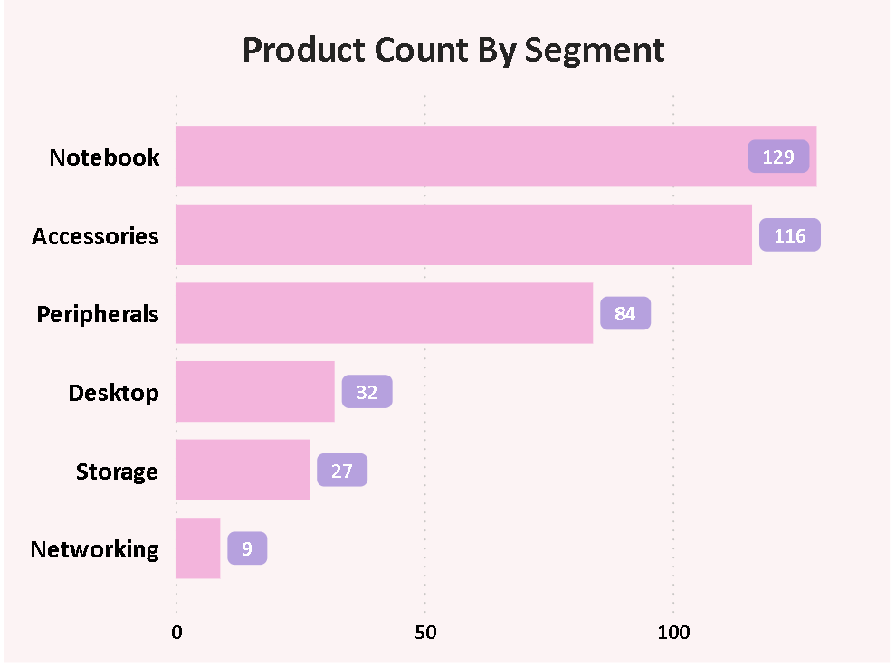
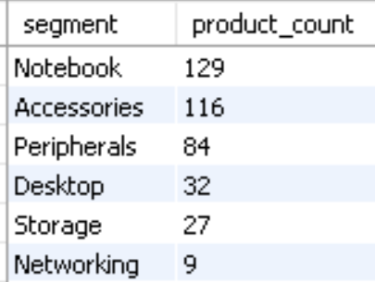
3. Provide a report with all the unique product counts for each segment and sort them in descending order of product counts. The final output contains 2 fields, segment, product_count .
Insight:
We offer a wide range of products in the Notebook, Peripherals, and Accessories segments, with an average of 110 products each. However, we need to expand our range in the Desktop, Networking, and Storage segments, which currently have only about 23 products each.

Slide 10
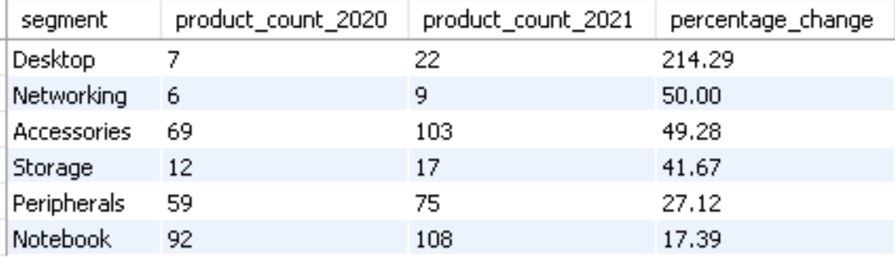
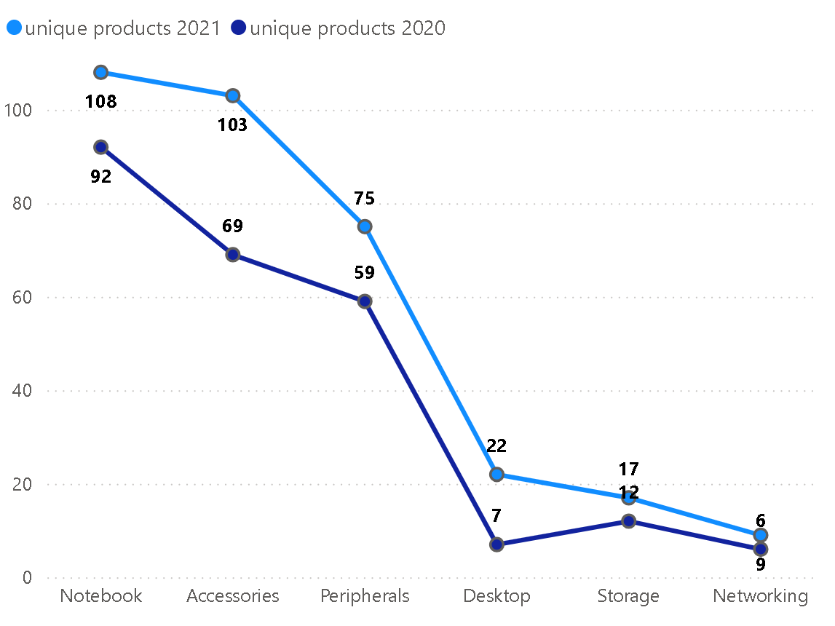
4. Follow-up: Which segment had the most increase in unique products in 2021 vs 2020? The final output contains these fields, segment, product_count_2020, product_count_2021, difference.
34
Insight:
The Accessories segment recorded the highest increase in production, while Storage and Networking showed comparatively slower growth.

Slide 11
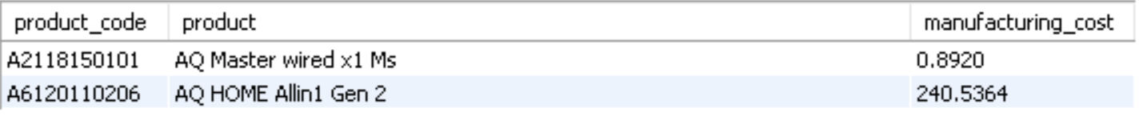
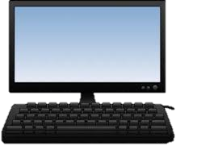
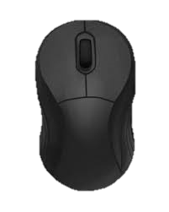
5. Get the products that have the highest and lowest manufacturing costs. The final output should contain these fields, product_code, product, manufacturing_cost.
$240.54
$0.89
Personal Desktop
AQ HOME Allin1 Gen2
Mouse
AQ Master Wired x1 Ms

Slide 12
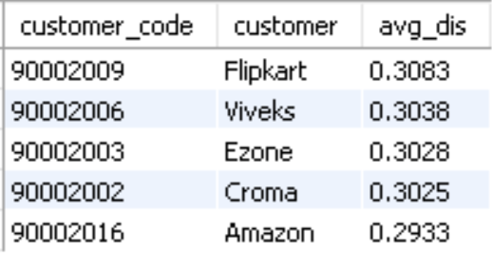
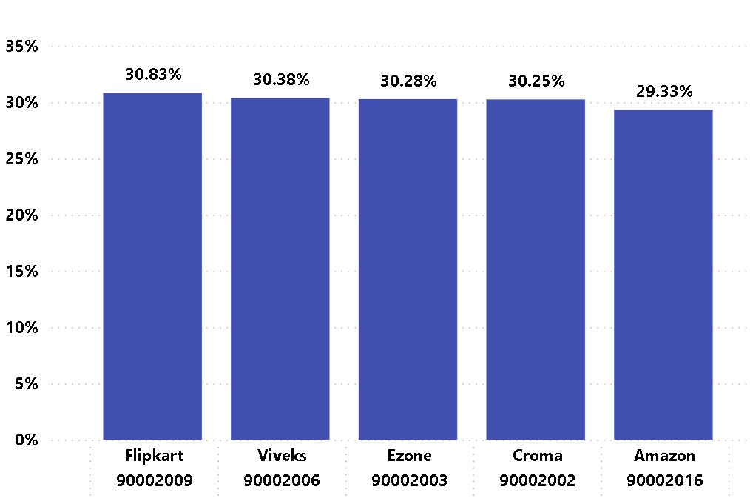
6. Generate a report which contains the top 5 customers who received an average high pre_invoice_discount_pct for the fiscal year 2021 and in the Indian market. The final output contains these fields, customer_code, customer, average_discount_percentage.
Insights:
In 2021, we gave similar pre-invoice discount percentages to our top 5 customers. Flipkart received the highest discount in the Indian market at 30.83%.

Slide 13
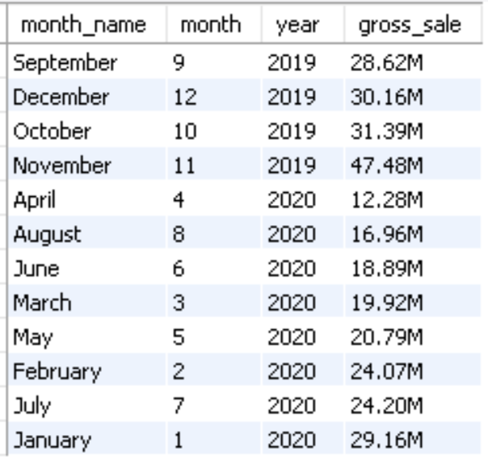
7. Get the complete report of the Gross sales amount for the customer “Atliq Exclusive” for each month . This analysis helps to get an idea of low and high-performing months and take strategic decisions. The final report contains these columns: Month, Year, Gross sales Amount.

Slide 14
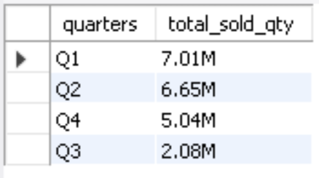
8. In which quarter of 2020, got the maximum total_sold_quantity? The final output contains these fields sorted by the total_sold_quantity, Quarter total_sold_quantity.

Slide 15
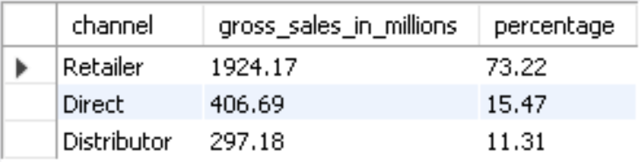
9. Which channel helped to bring more gross sales in the fiscal year 2021 and the percentage of contribution? The final output contains these fields, channel, gross_sales_mln, percentage.

Slide 16
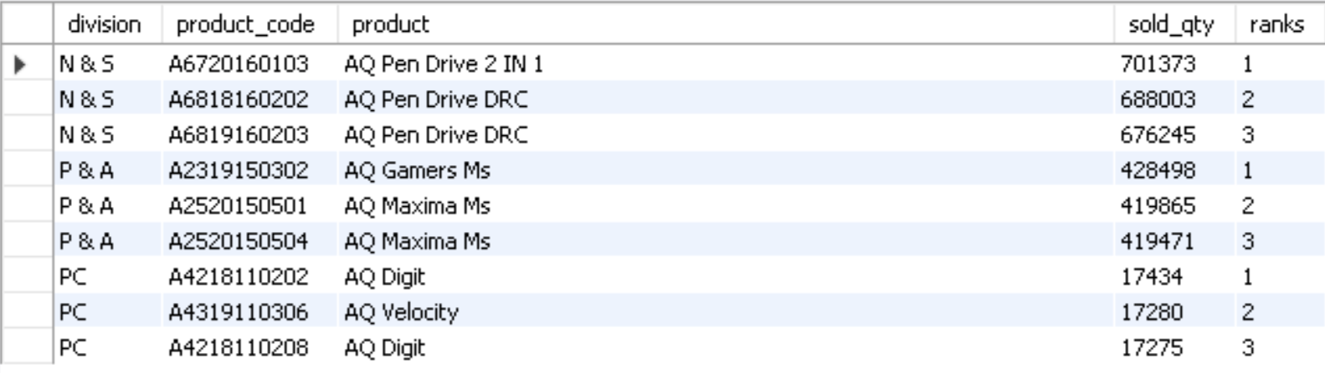
10. Get the Top 3 products in each division that have a high total_sold_quantity in the fiscal_year 2021? The final output contains these fields, division product_code, Product, total_sold_quantity, rank_order .

Slide 17


